Slide 1
Interfacing LCD with beaglebone black wireless project: IOT based smart car parking using beaglebone black wireless
SUBMITTED BY:
SRUTHY KRISHNAN
(749122)
GROUP #1

Slide 2
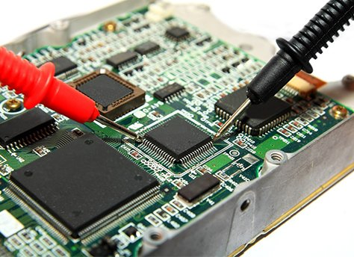
Contents
Introduction.
Interfacing Beaglebone black Wireless with 16x2 LCD
Connection details
Coding steps
Output and Hardware Circuit
References.

Slide 3
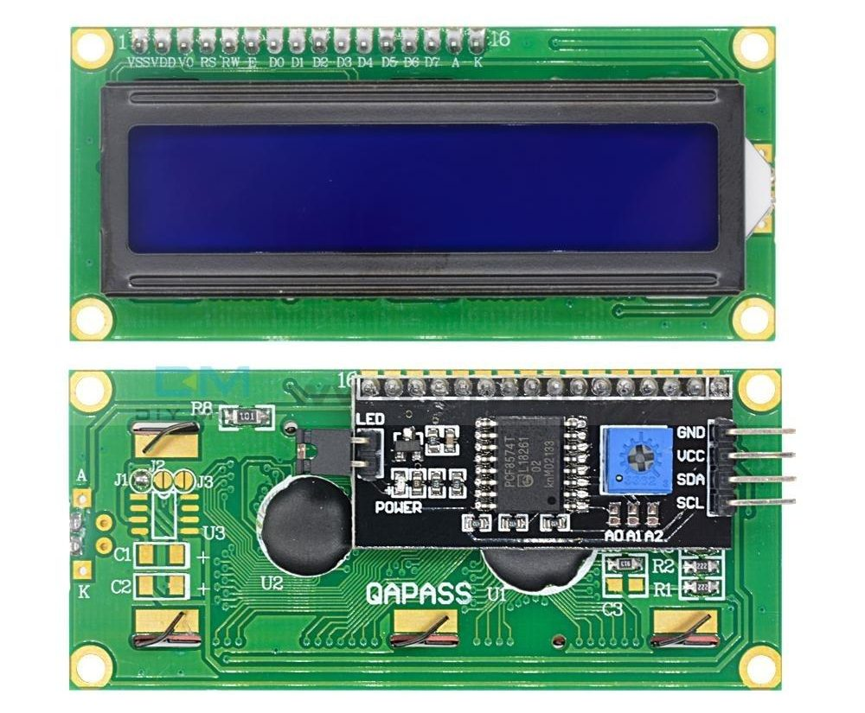
Introduction
Commonly used in most of the embedded projects
Operating voltage is 4.7V to 5.3V
It can display 16 characters per line and there are 2 such lines
It comes with I2C adapter soldered at the back of LCD
16x2 LCD is used in our project to display the available number of parking spots at the entrance

Slide 4
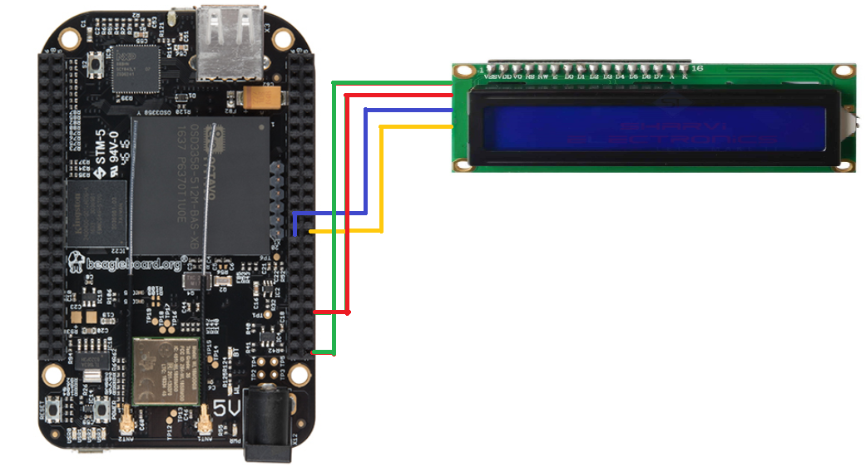
Interfacing lcd with beaglebone black wireless
16x2 LCD is connected to beaglebone black wireless using jumper wires
I2C communication is established with the help of I2C adapter
10K potentiometer is used to adjust the contrast of the LCD
Interfacing is done by using 4-bit mode as it requires fewer interface connections

Slide 5
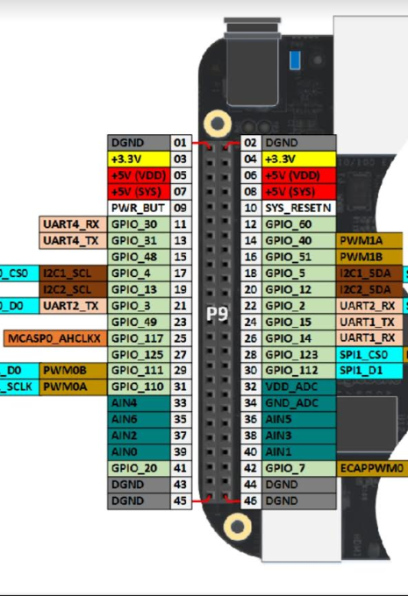
Connection details
LCD connection to Beaglebone Black Wireless
LCD BBB
GND ←→ GND
VCC ←→ SYS 5V
SCL ←→ P9_19
SDA ←→ P9_20

Slide 6
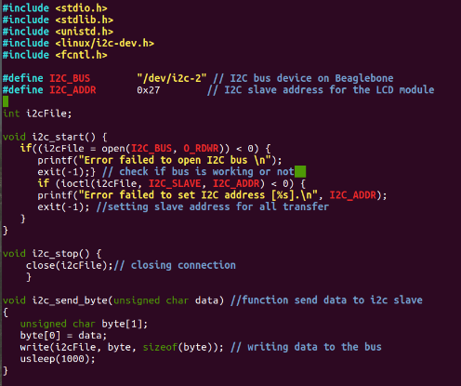
Coding steps
LCD module is used as a slave
Define I2C bus address as I2C bus 2 of BBB wireless
Initialized the slave address for the LCD module as 0x27
In order to check the bus address for I2C communication, void i2c_start() function is used.
This will check if the bus is working or not
void i2c_stop() function will close the connection
For sending bit by bit data towards the LCD, void i2c_send_byte() function is used

Slide 7
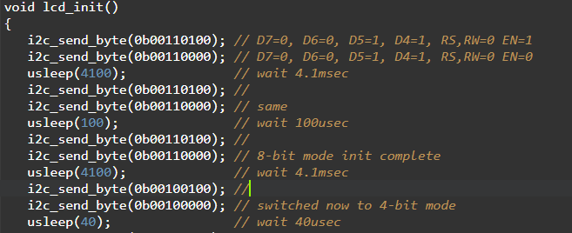
Contd…
void lcd_init() function initializes LCD and configure it in 4 bit mode
Initially the LCD will be in 8 bit mode.
Delay is added using “usleep” function

Slide 8
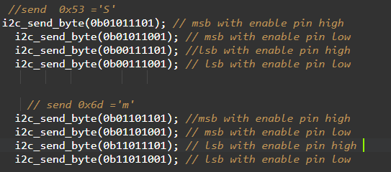
Contd…
Sending binary value of each character to I2C bus along with the status of enable pin
Data is given as MSB and LSB
3rd bit from the right is the enable pin status
Once the data is given, falling edge of enable pulse is required to write it on the LCD
“Smart Parking” will be displayed as the output on the LCD screen

Slide 9
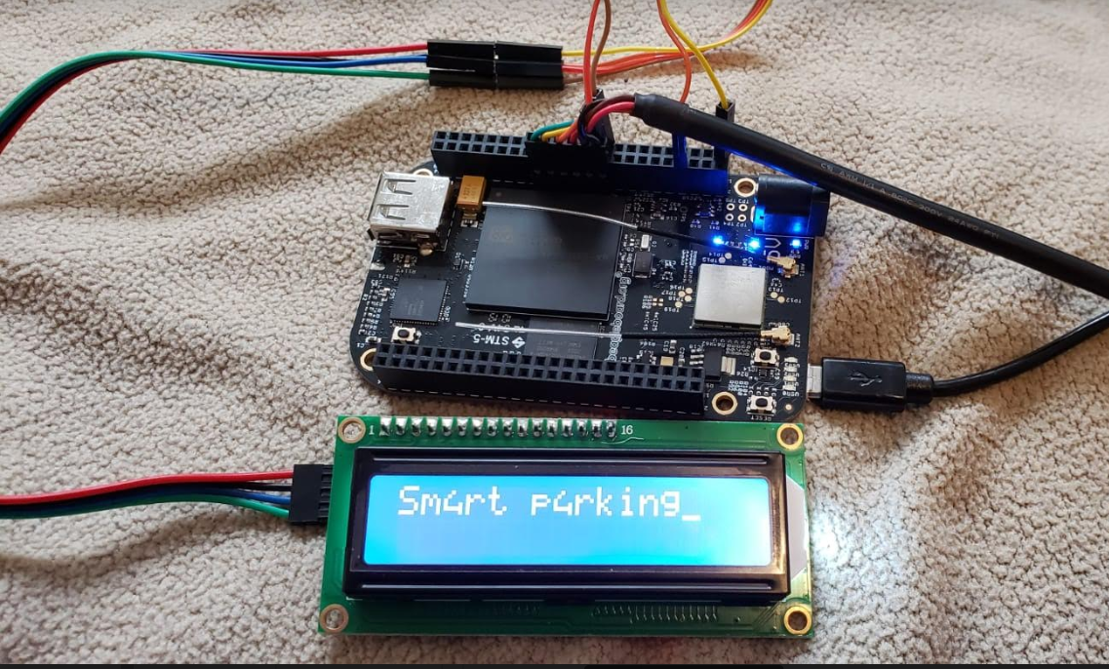
Output and hardware circuit

Slide 10
References
Elinux.org(2015). Beaglebone/I2CLCDDemo retrieved from: https://elinux.org/BeagleBone/I2CLCDDemo#I2C_LCD_wiring
Electronicsforu.com(2018). How 16x2 LCD work | Build a basic 16x2 character LCD retrieved from: https://www.electronicsforu.com/resources/learn-electronics/16x2-lcd-pinout-diagram
Siddharth(2013). Interface LCD in 4 bit Mode retrieved from: https://embedjournal.com/interface-lcd-in-4-bit-mode/

